Slide 1




Evidence for the Chiral Anomaly in the Dirac Semimetal Na₃Bi
Jun Xiong, Satya Kushwaha, Tian Liang, Jason Krizan, Max Hirschberger, Wudi Wang, R. Cava, N.P. Ong
Princeton University
Supported by MURI, ARO, Moore Foundation, NSF

Slide 2
Content
1 Introduction to the Weyl and Dirac semimetals
2 Introduction to the chiral anomaly effect
3 Transport evidence for the chiral anomaly in Na₃Bi
4 Chiral anomaly in GdPtBi, a zero-gap semiconductor with strong spin orbit coupling

Slide 3
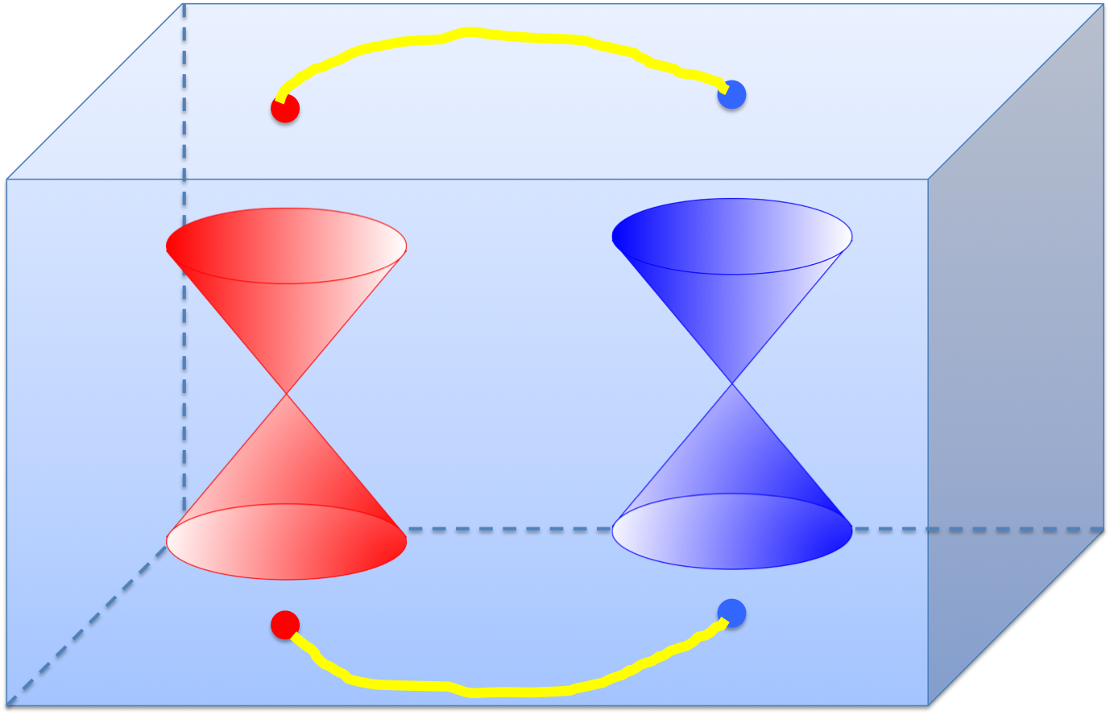
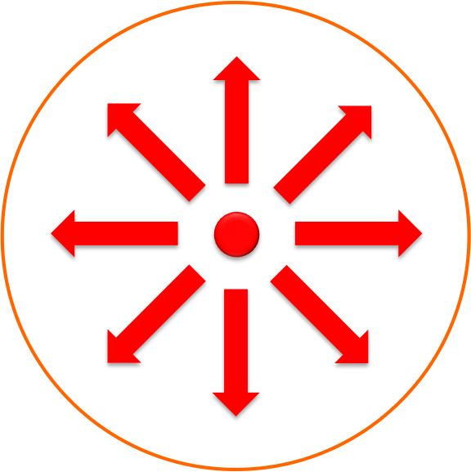
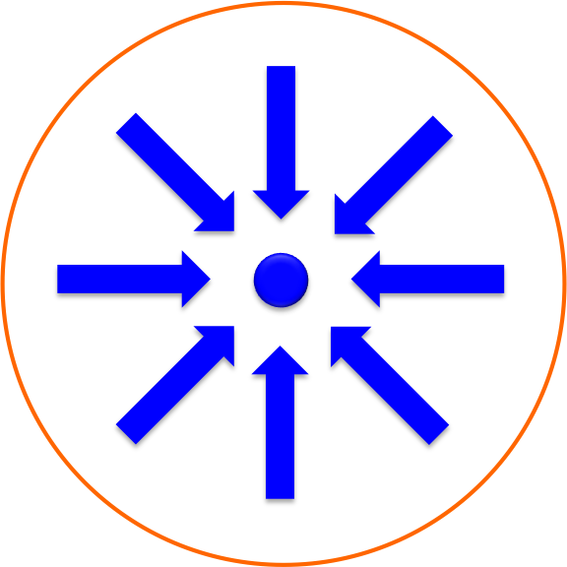
Weyl Node and Weyl Semimetal
Weyl branches have a linear
energy-momentum dispersion.
Similar to magnetic monopoles, Weyl nodes
serve as the sources and sinks of the Berry flux.
Berry vector potential
Berry flux
Fermi arcs connecting two Weyl nodes on the surface of TaAs
= 1
= -1
Hasan group, Science 2015
Notes:
Reduce the amount on Fermi arcs, briefly intro.
As we know, the Berry flux can be seen as magnetic field in the momentum space. And they can be calculated with the Bloch wavefunctions. So similar to magnetic monopoles, there are sinks and sources of Berry flux. They are called Weyl nodes. If we have a Fermi surface that encloses a Weyl node, it has a chirality of +1 or -1.
When such Weyl nodes exist at different positions in the momentum space of a crystal, the bands around them have a linear dispersion. And the crystal becomes a Weyl semimetal. A characteristic of the Weyl semimetal is the predicted surface Fermi arcs that connect the Weyl nodes. Such predictions of WSM have been confirmed by Photoemission experiments. For example, these are the results of ARPES experiments from Hasan. It shows two Weyl nodes in the WSM TaAs as well as the Fermi arcs that connect the two Weyl nodes.

Slide 4
Dirac Semimetal
The point group symmetry can prevent gap-opening when opposite Wely nodes meet. When T or I are broken, the Weyl nodes will be separated.
In Na₃Bi, the Dirac node is protected
by C₃ symmetry
Below shows how the Dirac node is split by the magnetic field
Wang et. al., PRB 2012
Notes:
Then what is a Dirac Semimetal? When a crystal has both time-reversal (T) & inversion (I) symmetries, the Weyl nodes with opposite chiral charges stay at the same positions in the Brillouin zone. When the opposite Weyl nodes meet, they usually annihilate and open a gap. But the point group symmetry in the crystal can prevent the gap-opening. Thus the linearly dispersed bands remain at these nodes. These nodes are also called Dirac nodes.
For example, Na3Bi crystals have a C3 symmetry along the z direction, and the Dirac nodes can exist on the kz axis as they are protected by the C3 symmetry.
First principle calculation from Xi Dai’s group predicts that Na3Bi is such a DSM. This pic shows the calculated band structure of Na3Bi,and its Dirac node on the kz direction.
(due to the C3 symmetry, there are two Dirac nodes along the kz direction. Here shows one Dirac node, and you can see the linear bands around it.)
When T or I is broken, the opposite Weyl nodes will be split. This pic is an example showing the splitting of two Weyl nodes in a magnetic field.

Slide 5
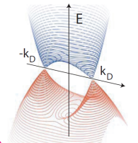
Band Structure of Na₃Bi
Only Na-3s and Bi-6p states lie near Fermi energy.
Crossings protected against gap formation
--- |S) and |P) states belong to different
irreducible representations of C₃.
Wang, et. al., PRB 2012
Protected by C₃ symmetry
2 Dirac nodes centered at K±
Na-3s
C
3
E
|S, ±½ )
60 meV
k_{D}
k_{z}
|P, ±3/2)
Bi-6p
Notes:
SOC -> Band inversion -> band crossings
Let’s take a look at DSM Na3Bi in details. The crystal has stacked layers of Na and Bi atoms. These atoms form hexagons in the crystal. It has C3 symmetry around the c axis. The relevant states are Na-3s and Bi-6p states, which are close to the Fermi energy. Due to strong SOC, the energy of s and p states shift and a band inversion happens. Thus there is a band crossing at kD on the kz axis. Due to the C3 symmetries, the crossings are protected from gap opening and we have two Dirac cones along the kz direction.

Slide 6
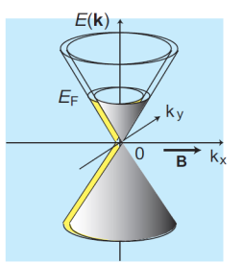
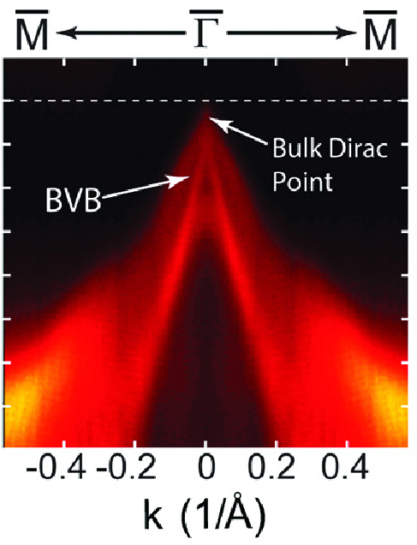
Hamiltonian and Chirality in Na₃Bi
The low-E Hamiltonian, close to node K₊, reduces to
Na
Bi
H resolves into two 2x2 Weyl Hamiltonians H₁, H₂
Wang, et. al., PRB 2012
The chirality is
We have a superposition of two opposite Weyl nodes at B = 0
Y. L. Chen Group, Science 2014
Notes:
The Hamiltonian of Na3Bi is a 4*4 matrix. Here we only retain the leading term and it’s linear in k. The off-diagonal terms are zero. As a result, the H can be resolved into two 2*2 Weyl H. H1 can be written by the product of the momentum, the velocity matrix v, and the the Pauli matrices. The determinant of the velocity matrix gives the chirality of the H. So the chirality of H1 is -1, and the chirality of H2 is 1.
As a result, at zero field, the Dirac node in Na3Bi can be regarded as the superposition of a pair of opposite Weyl nodes.
The pic is the ARPES data of the Dirac node in Na3Bi.

Slide 7



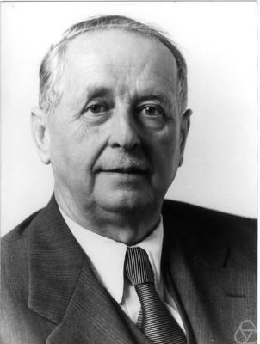
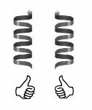
Weyl Fermion and Chiral Anomaly
Dirac Equation:
m = 0
Weyl Equations:
Describing left-handed and right-handed Weyl fermions with a conserved chirality.
For spin ½ fermion, the chirality operator is:
Notes:
Before we jump into the experimental data, let me briefly introduce the chiral anomaly effect. As we know, Fermions are described by the Dirac equation. The wavefunction psi in Dirac eq. has 4 components, and gamma is a 4*4 matrix. When the mass is zero, the Dirac equation can be reduced to two separate parts (2x2). These equations are Weyl equations, each of them has 2 components. And they describe left-handed and right-handed Weyl fermions respectively. Sigma are the Pauli matrices. These fermions have a conserved chirality in free space. So a left-handed Weyl fermion will not change to a right handed one at zero field.
The handedness of the particle is described by the chirality operator gamma5. It is the product of the spin and momentum operator. Thus if the spin direction is the same as the momentum direction, the chirality of the particle is 1, and it’s a right handed particle. Otherwise, the chirality is -1, and it’s a left handed particle.

Slide 8
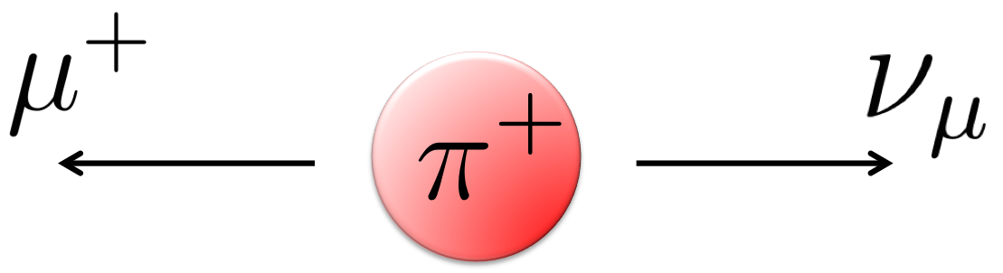
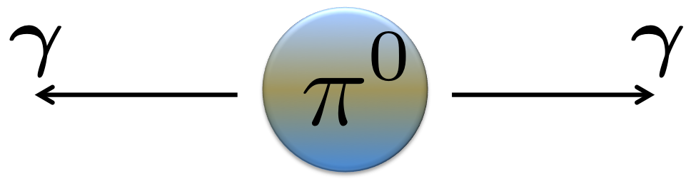
The Adler Bell Jackiw (or chiral) anomaly
The chiral symmetry is violated when Weyl fermions are coupled to the electro-magnetic field.
Charged pion decay
Neutral pion decay
Long lived charged poins decay only into leptons
Neutral pions break chiral symmetry by decaying into 2 photons (300 million times faster!)
(Adler, Bell, Jackiw, 1969)
The axial current is not conserved!
Notes:
Although the chirality is conserved in zero fields, a surprise is that the presence of parallel electric and magnetic fields will break the chirality conservation. This was found in the pion decay process. A charged pion decays into a muon and a neutrino. This process is slow. People found that a neutral pion decays into two photons and the process is 3*10^8 faster. Adler Bell and Jackiw found that the chiral symm is not conserved in this process. They found that the chiral current follows this equation here. So the right term is not zero. It means that the chiral charge can be created when E and B are parallel.

Slide 9
Chiral Anomaly in a Crystal
Nielsen and Ninomiya (Phys. Lett. 1983) proposed the chiral anomaly should appear in crystals.
Burkov, Science 2015
Last Landau Level is chiral in Weyl states.
+
A charge pumping effect between different branches of chiral Weyl nodes when E and B are parallel.
Notes:
Emphasize Landau levels here
In 1980s, Nielsen and Ninomiya suggested that the chiral anomaly effect can also appear in crystals. If you have both a left-handed Weyl branch and a right-handed Weyl branch in the crystal, parallel E and B can pump electrons from one branch to the other, breaking the chiral symmetry.
This pumping effect can be understood more easily with the help of Landau levels. As shown in this pic, the Weyl fermions will be quantized into Landau levels in the presence of parallel E and B. The lowest Landau level is chiral, and its energy-momentum dispersion is linear. We can obtain the degeneracy of the Landau level. As we learned in solid state physics class, the electric field will force the electrons move in momentum space. Thus the e in one Weyl branch will be pumped to the opposite Weyl branch. And the pumping rate is . Therefore, the total pumping rate is proportional to the E dot B term. And it agrees with the anomaly term for the chiral current.

Slide 10
Chiral Anomaly in a Crystal
In weak B, with B||E, using the Boltzmann kinetic equation:
and the relaxation time approximation, Son and Spivak (PRB, 2013) found a negative longitudinal magnetoresistance (LMR) as below:
τ_{a} is relaxation time
for pumped current
A long τ_{a} is essential for the observation of the negative LMR. τ_{a} increases with the decrease of E_{F}.
Notes:
Emphasize weak field here, list ingredients
We discussed the chiral anomaly effect when the Weyl branch is quantized into the lowest LL. Son and Spivak used Boltzmann kinetic equation and a relaxation time approximation to find that the chiral anomaly will cause a negative longitudinal magnetoresistance (LMR) when B || E. The longitudinal conductivity has a quadratic enhancement in B as described by the formula here. τ_{a} is relaxation time for pumped current.
From the formula, you can see that to get a large conductivity enhancement, we need a long τ_{a} as well as a small EF.

Slide 11

Na₃Bi Crystals with a High E_{F}
Kushwaha
Container used to protect and measure Na₃Bi
rapidly oxidized in
ambient air (30 s)
Notes:
To search for the chiral anomaly, we grow some Na3Bi crystals. They are grown by Satya Kushwaha from Cava lab. These are the pic of the Na3Bi crystals that we grow. The crystal is like a plate and has a distorted hexagonal shape. A difficult thing is that Na3Bi can be oxidized in air within 30s. So we have to seal the sample very well for the measurement. We have to mount contacts to the sample in a glove box, seal the sample in this container and quickly put the sample in the cryostat.
In our first sample growth effort, the R-T profile of the sample has a metallic behavior. Also, the Hall signal indicates a large carrier density, on the order of 10^19 cm^-3.

Slide 12
Linear Magnetoresistance in Na₃Bi Crystals with a High E_{F}
Linear MR in 8 samples
Notes:
This pic shows the MR of the Na3Bi crystals with a high EF. The MR of eight diff samples are all linear. When we tilt the magnetic field, the MR remains linear and positive. Even when B and E are parallel as shown by the curve at zero degree, the MR is linear. Thus in these Na3Bi crystals with a high carrier density, there is no evidence for chiral anomaly yet.

Slide 13
Negative Longitudinal Magnetoresistance in a Na₃Bi Crystal with a Low E_{F}
E || B
The non-metallic R v.s. T profile indicates a low E_{F} near the Dirac point.
Notes:
Then we made a lot of effort to reduce the carrier density in our crystals. In the end, we annealed the crystals for more than 1 month and got some crystals with a very low carrier density. Finally in these crystals, we observed evidence for the chiral anomaly effect.
The resistance v.s. T curve has a non-metallic behavior, consistent with the thermal excitation of carriers across the Dirac node. Also, the Hall signal changes sign at around 70 K. The sample is n-type at low T, but changes to p-type at higher T. As T increases, the zero gap also allows thermal excitation of a large amount of holes.
When we measure the longitudinal magnetoresistance, we finally observed the large negative MR when E || B. The MR has the largest decrease at 4.5 K and its amplitude gradually becomes smaller at higher T. We measured two samples, and the data is similar. Here is our first sample, here is the second one.

Slide 14
Na₃Bi crystals with a Low Carrier Density
Quantum Oscillations
small compared with
E_{F} ~ 30 meV, n ~ 10¹⁷ cm⁻³
Fermi sea volume determined by S_{F} in good agreement with density n inferred from R_{H}
Carrier mobility
μ = 3,000 cm²/Vs at 4 K
Hall Signals
Notes:
We also find out the carrier density from both the Hall signal and the Quantum oscillations. These are the quantum oscillations from MR after a background subtraction. Here the B is perpendicular to E. From the Landau index plot, we obtain the Fermi surface area. We can then calculate the kF of 0.012 A-1. This is small compared to the distance between the two Dirac nodes. The EF is 30meV. It corresponds to a carrier density of 10^17 cm^-3. This pic is the Hall signal at diff T, and the carrier density we obtain from the Hall signal agrees with the value from quantum oscillations.

Slide 15
A test for chiral anomaly -- B is locked to E
Negative MR appears only when B is locked to E.
Test: if E is rotated by 90º (right panel), neg. MR shifts to the new direction of E.
For weak B, this locking is novel and unexpected in semi-classical transport.
Notes:
We have observed the negative MR. And we hope to test whether it is consistent with the chiral anomaly effect. Thus we first rotate the B within the ab plane of the sample and measure the MR at different angles. We can see that when B and E are perpendicular, and the angle is 90, the MR is quasi-linear and positive. When we slowly decrease the angle, the MR comes down gradually. When the angle gets to below 20, the negative MR suddenly appears. This is consistent with the prediction of the chiral anomaly effect. When the angle is 90, the E dot B term is zero, so the pumping rate of the chiral current is 0, and there is no negative MR. When the angle is close to 0, the anomaly term reaches the max and we have the largest negative MR.
Besides, the anomaly term is only relevant to the relative angle between E and B. Thus if we change the direction of E, we should get similar MR patterns. To change the direction of E in situ, we can send the current through different contacts on the sample. We have six contacts on the sample. When we send the current through the leads 3 and 5, we rotate the current by 90. And we can see that the MR pattern at diff angles is similar to the left panel. When the angle is close to 90, the MR is linear and positive. When the angle is close to 0, we obtain the negative MR. This is also consistent with the chiral anomaly effect.
The scattering rate also grows with the field, as the DOS grows, so it saturates at high B

Slide 16
A narrow plume of chiral current, B in-plane
Enhanced cond. in a narrowly collimated beam for B in the x-y (horizontal) plane
Notes:
We also hope to find the angular dependence of the axial current in Na3Bi. We fix the strength of B, and rotate the B with the ab plane. You can see that at low B, the conductivity enhancement has a relative broad dependence on the angle. The conductivity enhancement reaches the max at 0 degree, and reaches min around 90 degree. The dotted lines are the fit to cos^4 theta. The inner panel is the polar plot that shows the conductivity enhancement in the xy plane.
When the field gets higher, the angular dependence of the conductivity enhancement also becomes sharper. The polar plot shows similar behavior. And we can not use a power law of cos theta to fit the curve. It indicates that the enhanced cond. is like a narrowly collimated beam along the direction of B.

Slide 17
Width of chiral conductivity “plume”, B normal to plane
Enhanced cond. in a narrowly collimated beam for B rotated in the x-z (vertical) plane
Notes:
Then we rotate B in the x-z plane as well. And the data is similar. At low B, the conductivity enhancement also has a broad dependence on the angle. It’s also shown by the polar plot in the inner panel. The fit to cos^4 theta is only good at low field.
When the field gets above 3T, the conductivity enhancement becomes much sharper around 0 degrees. The polar plot shows the narrow enhancement at 0. And we can not fit the curve with cos theta functions either. Thus the data is similar to that in the xy plane.

Slide 18
Signature of chiral anomaly: B locks direction of axial current
Locking of observed axial current to B (even in weak B) seems to be a signature characteristic of the chiral anomaly.
Axial plume direction fixed by B (and E)
Notes:
Therefore, the axial current is like a narrow plume that is locked to the direction of the magnetic field and electric field. And we think it is a signature of the chiral anomaly. We hope that there can be detailed theory that studies the angular dependence of the negative MR caused by the chiral anomaly effect.

Slide 19
Relaxation time τ_{a} of the pumped axial current
In semiclassical regime, Weyl node conductivity grows as B² (Son, Spivak, PRB ‘13).
The fitting implies: the axial current relaxation time τ_{a} ~ 40 – 80 τ₀ (τ₀ is the Drude life time).
Possible reasons for the suppression of the axial current relaxation:
Suggested by Nielson and Ninomeya: Charged impurities are well screened (Thomas-Fermi factor ) for large valley scattering (Δk >> k_{F} ).
Suggested by Burkov: Violation of chiral symmetry is weak at low B, so the impurities may not scatter the axial current strongly.
Notes:
Then we hope to obtain the relaxation time tau_a of the axial current as well. These are the cond. V.s. B profiles for two samples. When B || E, the conductivity follows a quadratic behavior at low B in both samples. Thus we can fit the conductivity enhancement to the formula by Son & Spivak. We obtain the axial current relaxation time, which is about 40 – 80 times of the Drude life time. This means that there is a strong suppression of the axial current relaxation.
This is unexpected, and there are different possible reasons. Nielson and Ninomeya suggested that charged impurities are well screened for large valley scattering. But we don’t quite believe that’s the case in Na3Bi. We think it’s more likely due to the reason below, i.e. Violation of chiral symmetry is weak at low B, so the impurities may not scatter the axial current strongly. But this remains a puzzle for future theoretical studies.

Slide 20
High-Field Kink
A turn-up trend at high field may indicate novel physics in high field.
Notes:
The above data mainly focus on the low and medium range of magnetic fields. We also measured the sample up to 35 T. And we find some interesting things in both of our samples. As you can see, when the angle is large and close to 90, there is a kink above 25 T. The MR turns up rapidly above the kink field. It probably indicates a gap-opening at high B. It’s certainly worth more studies in the future.

Slide 21
Weyl Nodes in the half-Heusler GdPtBi
Hirschberger, et. al., arXiv: 1602.07219
GdPtBi
Na₃Bi
Notes:
Here I also hope to introduce another material that shows evidence for chiral anomaly. The material is a half-Heusler compound, GdPtBi. It has a zinc blende structure. Here is the Brillouin zone. According to first principle calculation, near the EF, the crystal has a touching point at the Gamma point. And each band has a degeneracy of two here, so there’s a total degeneracy of 4 at Gamma point. In a magnetic field, the different Zeeman energy of the bands lead to opposite Weyl nodes. And it also provides a platform for the study of Weyl physics.
When we apply B parallel to the current, we can also observe a large negative MR signal. It’s very similar to the negative MR of Na3Bi. The negative MR is the largest at low T, and gradually becomes smaller at higher T. It’s there until around 100K.
(zinc blende structure structure, put zhijun wang’s bands here, Bi 6p states. Zero gap in zero field. A carton what think is happening. The zeeman energy will shift red up, blue down, depends on the direction of the field, axis dependent. The crossings are protected. Imitate Na3Bi,put MR(at diff T) together. C The perpendicular field drops R by five times or higher)
(The non-metallic RT profile and the sharp decrease in Hall density is consistent with the zero gap feature.)

Slide 22
Negative Magnetoresistance in the half-Heusler GdPtBi
GdPtBi
Na₃Bi
Notes:
We also rotate the magnetic field to test the angular dependence of the MR. When B is deviated from I, the negative MR gradually becomes smaller and in the end it becomes positive. This trend is also similar to that of Na3Bi.
The angular dependence of the conductivity enhancement in GdPtBi is similar to that of Na3Bi as well. It’s the largest around 0 degree. And when the B field increases, the enhancement becomes sharper. As we discussed earlier, this is a characteristic feature of chiral anomaly. Thus it provides support for the chiral anomaly effect in GdPtBi.
(When B || I,negative. then B has two jobs, creating the Dirac nodes and then chiral anomaly. Not oscillations,SF ~30T. The plume is non-cos like.
Order at 8K, goes anti-ferromagnet,)

Slide 23
Conclusion
Negative longitudinal magnetoresistance in non-metallic Na₃Bi.
Qualitatively consistent with the chiral anomaly effect when rotating both E and B.
The axial current is locked to B and E.
τ_{a} ~ 40 – 80 τ₀
GdPtBi shows evidence for the chiral anomaly effect
Thank You!

Slide 24
Thank You!

Slide 25
Weyl Nodes in the half-Heusler GdPtBi
Khmelevskyi, PRB 2012
Notes:
zinc blende structure structure, put zhijun wang’s bands here, Bi 6p states. Zero gap in zero field. A carton what think is happening. The zeeman energy will shift red up, blue down, depends on the direction of the field, axis dependent. The crossings are protected. Imitate Na3Bi,put MR(at diff T) together. C The perpendicular field drops R by five times or higher
Here I also hope to introduce another material that shows evidence for chiral anomaly. The material is a half-Heusler compound, GdPtBi. It has zinc blende structure. Here is the Brillouin zone. According to first principle calculation, near the EF, the crystal has a touching point at the Gamma point. And each band has degeneracy of two here, so there’s a total degeneracy of 4 at Gamma point. In a magnetic field, the different Zeeman energy of the bands lead to opposite Weyl nodes. And it also provides a platform for the study of Weyl physics.
The non-metallic RT profile and the sharp decrease in Hall density is consistent with the zero gap feature.

